Slide 1

AI Depression Analysis System
Deployment Presentation
Agile Production Development
FastAPI
GitHub CI/CD
Docker
Azure
Dhruv Marwal(I043) | Priyanshu Jha (I034) | Shivang Jain (I030)

Slide 2
Project Overview
What we built and why we deployed it
The Project
Tech Stack
AI-powered web application for automated depression screening
Users answer PHQ-9 questionnaire + chat interface
Backend: FastAPI (Python) with ML models
Frontend: HTML + JavaScript UI
Goal: Deploy as scalable, public-facing cloud application
Frontend
HTML / JavaScript
API Layer
FastAPI (Python)
ML Models
PyTorch · Transformers · DEAP
Container
Deployment Goals
Docker
Make the app accessible from anywhere via public URL
Containerize for environment consistency
Automate future deployments with CI/CD
Registry
Azure Container Registry (ACR)
Cloud Hosting
Azure App Service (B1 Linux)
CI/CD
GitHub Actions

Slide 3
System Architecture
End-to-end architecture of the deployed system
User
Browser
FastAPI
Backend
ML
Modules
Docker
Container
Azure
ACR
Azure App
Service
→
→
→
→
→
HTML/JS
Python 3.10
PHQ9·Sentiment·Fuzzy
neurofuzzy-app
Image Registry
Public URL
Backend Modules
Deployment Infrastructure
CI/CD Pipeline
PHQ-9 Scorer – questionnaire analysis
Sentiment Analyzer – emotion from chat
Fuzzy Logic Engine – inference system
Classifier – final depression category
Docker image: neurofuzzy-app:latest
ACR: neuroregistry123.azurecr.io
App Service Plan: B1 (Linux)
Port: 8000 → WEBSITES_PORT
GitHub Actions on push to main
Auto docker build + push to ACR
Auto Azure Web App restart
Zero-touch deployment

Slide 4
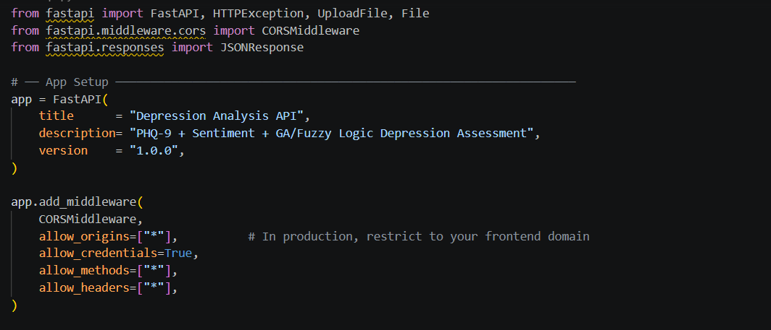
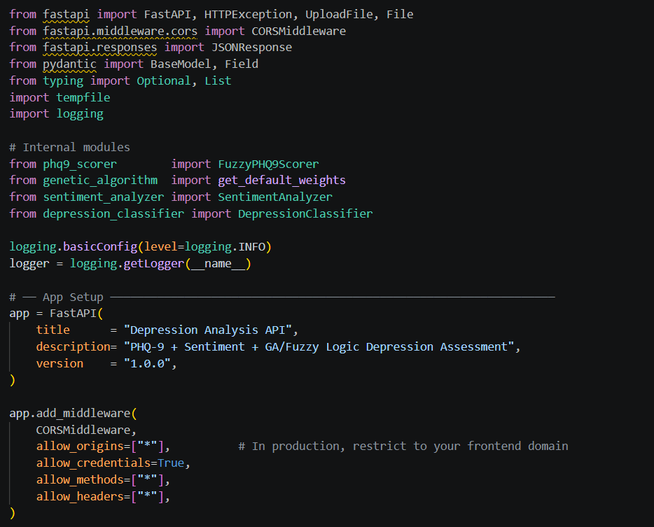
Backend Development (FastAPI)
Building the core API server in Python
Why FastAPI?
Modern, high-performance Python web framework
Automatic Swagger UI at /docs
Built-in async support
Easy integration with ML models
JSON API responses out of the box
CORS Configuration
App Structure
CORSMiddleware added to allow all origins
Required for frontend-backend cross-origin calls
allow_origins=["*"] for development
Prevents 'Failed to fetch' errors
Project root → backend/ + frontend/ + Dockerfile + requirements.txt
Uvicorn ASGI server: uvicorn backend.api:app --host 0.0.0.0 --port 8000
ML models loaded at startup (PHQ9 scorer, sentiment, classifier)
Frontend served from FastAPI static file response at root route /

Slide 5
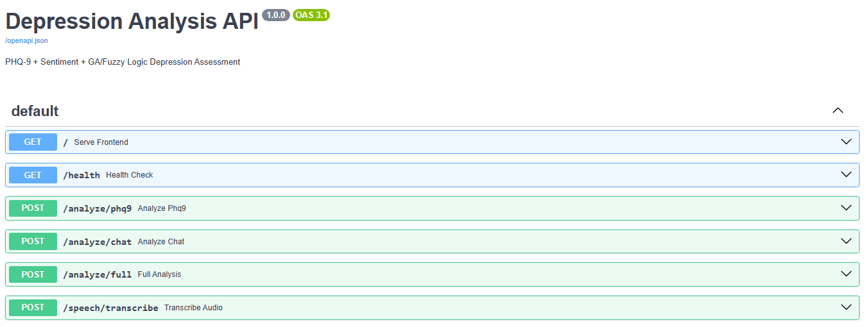
API Endpoints Design
RESTful endpoints powering the depression analysis system
Serves the frontend index.html file
Returns server status and loaded modules
Full depression analysis (PHQ-9 + chat)
Sentiment analysis from conversation text
Standalone PHQ-9 questionnaire scoring

Slide 6
Local Testing & Validation
Verifying the app works before containerizing
Why Test Locally First?
$ terminal
Catch errors before adding Docker complexity
Faster iteration without image rebuild cycles
Verify ML models load and run correctly
Test all API endpoints with Swagger UI at /docs
Ensure frontend connects to backend successfully
# Start server locally
uvicorn backend.api:app --host 0.0.0.0 --port 8000
# Expected output:
INFO: Application startup complete.
INFO: Uvicorn running on http://0.0.0.0:8000
# Test endpoints:
curl http://localhost:8000/health
# → {"status":"ok","modules":["phq9_scorer",...]}
curl -X POST http://localhost:8000/analyze/chat \
-d '{"text":"I feel hopeless today"}'
Validation Steps
Run: uvicorn backend.api:app --port 8000
Open: http://localhost:8000/docs
Test /health → modules loaded?
Test /analyze endpoints with sample data
Confirm frontend UI loads and calls API
✅ Local validation passed:
Swagger UI responsive • Models load in ~30s • All endpoints return JSON

Slide 7
Introduction to Docker
Containerization — packaging the app for any environment
What is Docker?
Container vs Traditional Deploy
Platform to build, ship and run applications in containers
A container packages code + dependencies + OS layer
Runs identically on any machine: dev, staging, cloud
Eliminates 'works on my machine' problem
Aspect
Traditional
Docker
Setup
Manual install
One command
Why Docker for our project?
Environment
Varies per machine
Always consistent
ML models require exact Python + library versions
Azure App Service natively supports Docker containers
Single image can be versioned (v1, v2 ... latest)
Easy rollback to previous version if deploy fails
Deploy
Copy files + hope
docker run
Scale
Complex
Simple
Docker Key Concepts Used
Image – blueprint of our app (built with Dockerfile) • Container – running instance of the image
Tag – version label (v1, v2, latest) • Registry – remote image storage (Azure ACR)

Slide 8
Dockerfile Setup
Defining how our app container is built
$ terminal
Base Image Choice
# Use lightweight Python base image
FROM python:3.10-slim
# Set working directory inside container
WORKDIR /app
# Copy dependency list first (layer cache optimization)
COPY requirements.txt .
# Install Python dependencies
RUN pip install --no-cache-dir -r requirements.txt
# Install CPU-only PyTorch (smaller image size)
RUN pip install --no-cache-dir \
--extra-index-url https://download.pytorch.org/whl/cpu \
-r requirements.txt
# Copy entire project (backend/ + frontend/)
COPY . .
# Expose app port
EXPOSE 8000
# Start FastAPI with Uvicorn
CMD ["uvicorn", "backend.api:app",
"--host", "0.0.0.0", "--port", "8000"]
python:3.10-slim → minimal, no GUI
Reduces image size significantly
All ML libs installable via pip
Compatible with Azure Linux containers
Layer Caching Strategy
COPY requirements.txt FIRST
RUN pip install as a separate layer
Docker caches if requirements unchanged
Subsequent builds skip reinstall → faster
CPU-only PyTorch
torch==2.3.0+cpu → removes CUDA packages
Reduces image from ~5GB to ~1.85GB
Azure App Service has no GPU access
Faster container startup in cloud

Slide 9
Building Docker Image
Creating the container image from our project
$ terminal
Build Command Explained
# Navigate to project root
cd C:\Codes\neurofuzzy-depression-analysis
# Build Docker image (tag it "neurofuzzy-app")
docker build -t neurofuzzy-app .
# Verify image was created
docker images
# REPOSITORY TAG IMAGE ID SIZE
# neurofuzzy-app latest 24d1218c... 1.85GB
docker build → triggers Dockerfile
-t neurofuzzy-app → assigns name tag
. (dot) → build context = current folder
Copies all project files including frontend/
Executes RUN commands, sets CMD
$ terminal
Run Command Explained
# Run container locally to test before cloud deploy
docker run -p 8000:8000 neurofuzzy-app
# Expected console output:
INFO: Application startup complete.
INFO: Uvicorn running on http://0.0.0.0:8000
# Test in browser:
# http://localhost:8000/docs → Swagger UI ✅
docker run → start container from image
-p 8000:8000 → host:container port mapping
Maps laptop port 8000 → container port 8000
If local test passes → Azure will work too
Confirms image is complete and functional
✅ Key Insight:
If the app runs locally in Docker → it will run identically on Azure. This is the core promise of containerization.

Slide 10
Handling Dependency Issues
Real problems encountered and how we solved them
Issue 1: pyaudio Build Failure
❌ Problem: error: command 'gcc' failed — pyaudio requires C compiler to build
✅ Fix: Removed pyaudio + SpeechRecognition from requirements.txt
Cloud has no microphone hardware — audio input not needed on Azure
Issue 2: Huge Docker Image (~5GB)
❌ Problem: torch default install includes NVIDIA CUDA (~2GB extra). Azure B1 plan crashes on memory overload.
✅ Fix: Used CPU-only PyTorch:
--extra-index-url https://download.pytorch.org/whl/cpu
torch==2.3.0+cpu → Image shrunk to 1.85GB
Issue 3: requirements.txt Syntax Error
❌ Problem: Wrote torch==2.3.0+cpu --extra-index-url on SAME line → pip parse error
✅ Fix: Moved --extra-index-url to Dockerfile RUN command separately:
RUN pip install --extra-index-url https://...whl/cpu -r requirements.txt

Slide 11
Docker Image Versioning (Tags)
Managing multiple versions of our deployment
What are Tags?
Version Timeline
Labels attached to Docker images for version tracking
Format: repository:tag (e.g. neurofuzzy-app:v3)
Default tag is 'latest' if none specified
Multiple tags can point to same image ID
Critical for rollback and reproducibility
v1
Initial push to ACR
v2
Fixed Dockerfile CMD order
$ terminal
v3
Removed duplicate CMD statements
# Tagging images for Azure ACR
docker tag neurofuzzy-app \
neuroregistry123.azurecr.io/neurofuzzy-app:v1
docker tag neurofuzzy-app \
neuroregistry123.azurecr.io/neurofuzzy-app:v3
# For CI/CD automation (always latest)
docker tag neurofuzzy-app \
neuroregistry123.azurecr.io/neurofuzzy-app:latest
# Our version progression:
# v1 → initial deploy
# v2 → Dockerfile CMD fix
# v3 → CMD order fix
# v5–v8 → frontend integration fixes
# latest → CI/CD automated builds
v5
Fixed frontend folder not included
v7
Added safe FileResponse with path check
v8
Fixed API BASE_URL for production
latest
CI/CD auto-build on every git push

Slide 12
Pushing Image to Azure Container Registry (ACR)
Uploading our Docker image to the cloud registry
What is ACR?
$ terminal
Azure's private Docker image registry
Like Docker Hub but private to our Azure account
Azure App Service pulls images directly from ACR
Supports access credentials and admin login
# STEP 1: Create Container Registry
az acr create --resource-group neuro-rg \
--name neuroregistry123 --sku Basic
# STEP 2: Enable admin credentials
az acr update -n neuroregistry123 --admin-enabled true
# STEP 3: Login to ACR from local machine
az acr login --name neuroregistry123
# STEP 4: Tag image with full ACR path
docker tag neurofuzzy-app \
neuroregistry123.azurecr.io/neurofuzzy-app:v1
# STEP 5: Push image to ACR
docker push neuroregistry123.azurecr.io/neurofuzzy-app:v1
# Expected output:
# v1: digest: sha256:cdb3bf33... size: 856
# ✅ Push complete
ACR Admin Credentials
2 passwords generated (primary + secondary)
Password 1: primary usage
Password 2: backup for rotation (zero-downtime key change)
Used by Azure Web App to pull images securely
Push Success Confirmation
digest: sha256:... confirms image integrity
Layer already exists = efficient incremental push
Only changed layers are re-uploaded
Registry URL: neuroregistry123.azurecr.io

Slide 13
Azure Cloud Setup (Resource Group & App Service)
Setting up the cloud infrastructure for deployment
$ terminal
Resource Group
# STEP 1: Login to Azure CLI
az login --use-device-code
# Visit https://microsoft.com/devicelogin
# Enter code → authenticate
# STEP 2: Create Resource Group
az group create --name neuro-rg \
--location centralindia
# Groups all project resources together
# STEP 3: Create App Service Plan (Linux B1)
az appservice plan create \
--name neuro-plan \
--resource-group neuro-rg \
--sku B1 --is-linux
# STEP 4: Create Web App (container-based)
az webapp create \
--resource-group neuro-rg \
--plan neuro-plan \
--name neurofuzzy-depression \
--deployment-container-image-name \
neuroregistry123.azurecr.io/neurofuzzy-app:v1
Logical container for all Azure resources
Name: neuro-rg | Region: Central India
Contains: ACR + App Service Plan + Web App
Delete group → deletes all resources at once
App Service Plan (B1)
Defines compute power: 1 core, 1.75GB RAM
B1 = Basic tier — supports custom containers
--is-linux required for Docker containers
Shared by all Web Apps under the plan
Azure CLI Note
Use single-line commands in PowerShell
Line continuation: backtick (`) not backslash
az --version to verify CLI installation
az account show to confirm subscription

Slide 14
Deploying Container to Azure Web App
Connecting the Docker image to Azure App Service
Deployment Center Setup
(Azure Portal)
$ terminal
App Service → Deployment Center → Containers
Source: Azure Container Registry
Registry: neuroregistry123
Image: neurofuzzy-app
Tag: v8 (or latest for CI/CD)
Auth: Admin Credentials
Click Save → Azure pulls image automatically
# Configure container source via CLI
az webapp config container set \
--name neurofuzzy-depression \
--resource-group neuro-rg \
--container-image-name \
neuroregistry123.azurecr.io/neurofuzzy-app:v1 \
--container-registry-url \
https://neuroregistry123.azurecr.io \
--container-registry-user neuroregistry123 \
--container-registry-password <PASSWORD>
# Restart to apply changes
az webapp restart \
--name neurofuzzy-depression \
--resource-group neuro-rg
Deployment Flow
Container Status States
1. Azure pulls image from ACR using credentials
2. Container is started on Linux B1 instance
3. Uvicorn serves FastAPI on port 8000
4. Azure proxies port 80/443 → port 8000
5. Public URL becomes accessible globally
URL: https://neurofuzzy-depression.azurewebsites.net
Starting → container boot in progress
Running → app serving requests ✅
Unknown → timeout or crash during boot
Blocked → SiteStartupCancelled (timeout hit)
Stopped → app crashed after startup
Fix: check Log Stream for exact error

Slide 15
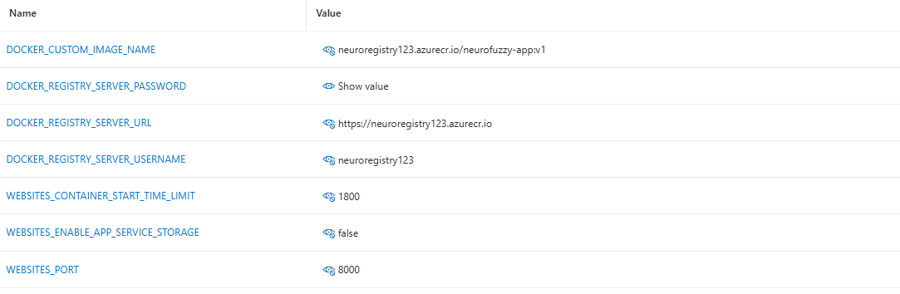
Configuring Port & Environment Variables
Critical Azure settings for container to work correctly
Why It's Needed
Why It's Needed
ACR admin password (sensitive credential)
ACR server URL for image pull authentication
ACR admin username for authentication
Extends startup timeout to 30min for heavy ML model loading
Tells Azure which port the container listens on (default is 80)
$ terminal
Key Lesson
az webapp config appsettings set --name neurofuzzy-depression \
--resource-group neuro-rg \
--settings WEBSITES_PORT=8000 WEBSITES_CONTAINER_START_TIME_LIMIT=1800
Azure proxies port 80→8000 via WEBSITES_PORT
Without this: 'Application Error' on every request
Startup timeout fix essential for ML models

Slide 16
Debugging with Azure Log Stream
Reading real-time logs to diagnose deployment issues
What is Log Stream?
Log Messages We Encountered
Real-time live log viewer inside Azure Portal
Shows container stdout/stderr in browser
Path: App Service → Log stream (left sidebar)
Also accessible via Azure CLI
Essential for diagnosing container crashes
ContainerTimeout (230 sec expired)
→ Increased start limit to 1800s
Uvicorn running on http://0.0.0.0:8000
→ App started successfully ✅
$ terminal
Application startup complete.
# View live logs from CLI
az webapp log tail \
--name neurofuzzy-depression \
--resource-group neuro-rg
# Common success messages:
INFO: Application startup complete.
INFO: Uvicorn running on http://0.0.0.0:8000
# Common failure messages:
ContainerTimeout → startup > 230s
'Killed' → Out of memory
ModuleNotFoundError → missing package
→ All models loaded ✅
No credential was provided to access ACR
→ Set DOCKER_REGISTRY_SERVER_PASSWORD
GET / HTTP/1.1 404 Not Found
→ Normal — no route defined at /
Shutting down / Application shutdown complete
→ Azure killing slow-start container
{"status":"ok","modules":[...]}
→ Health check passed ✅

Slide 17
Frontend Integration with Backend API
Connecting the HTML/JS UI to our deployed API
$ terminal
CORS — Why It Matters
// ❌ WRONG — won't work in production
const API = "http://localhost:8000";
// ✅ CORRECT — points to live Azure URL
const API = "https://neurofuzzy-depression.azurewebsites.net";
// API calls use the variable (no other changes needed)
fetch(`${API}/analyze/phq9`, {
method: "POST",
headers: { "Content-Type": "application/json" },
body: JSON.stringify(phq9Data)
});
Browser blocks cross-origin API requests by default
Frontend on domain A → calls API on domain B = blocked
FastAPI CORSMiddleware allows our frontend to call API
allow_origins=['*'] permits all origins for dev
Without this: 'Failed to fetch' errors in browser console
Serving Frontend from FastAPI
Integration Architecture
FastAPI serves index.html at GET / route
os.path.join(os.getcwd(), 'frontend', 'index.html')
FileResponse streams HTML file to browser
Docker COPY . . includes entire frontend/ folder
No separate web server (nginx) needed
Browser loads index.html from Azure App URL
JS form submission → fetch(API + /analyze/full)
FastAPI processes → returns JSON result
Frontend renders depression analysis result
Same domain = no CORS issues in our setup
Pro Tip for future:
Use const API = window.location.origin; — automatically detects localhost OR production Azure URL, making the code work in both environments without changes.

Slide 18
Fixing API Connectivity Issues
Diagnosing and resolving frontend-backend connection problems
Error: "Failed to fetch"
Cause: Frontend JavaScript was calling http://localhost:8000 — which doesn't exist on Azure's servers
✅ Fix: Changed: const API = "https://neurofuzzy-depression.azurewebsites.net"
Rebuild Docker image → push v8 → update Azure → restart
Error: 500 Internal Server Error on GET /
Cause: FileResponse('frontend/index.html') — relative path failed because working directory mismatch inside container
✅ Fix: Used os.path.join(os.getcwd(), 'frontend', 'index.html') for absolute path
Added existence check to return helpful error instead of crash
404 on /frontend/index.html
Cause: Initially thought frontend folder wasn't in container. Confirmed it was included (COPY . . copies all), but path resolution was wrong
✅ Fix: Fixed FileResponse to use absolute path. Static route at / now correctly returns index.html

Slide 19
Successful Deployment Verification
Confirming the live system works end-to-end
🚀 App Live at: https://neurofuzzy-depression.azurewebsites.net
Endpoint
Verification Result
✅ /health
{"status":"ok","modules":["phq9_scorer","sentiment_analyzer","classifier"]}
✅ /docs
Swagger UI loaded — all 5 API endpoints listed and testable
✅ /
Frontend HTML page loads correctly in browser
✅ /analyze/full
POST with PHQ-9 data returns depression classification JSON
✅ /analyze/chat
POST with chat text returns sentiment + depression score
Runtime Status: Healthy • Container: v8 running • API modules: 3 loaded • First response time: ~30s (model loading) • Subsequent: <2s

Slide 20
Challenges Faced During Deployment
Real-world obstacles encountered on the path to production
🐳 Docker Build
⚙️ Container Startup
pyaudio requires gcc compiler not present in slim image
torch default pulls 2GB CUDA — container too heavy
Docker Desktop not running: daemon connection error
CMD specified twice in Dockerfile — last one silently wins
ContainerTimeout after 230 seconds — ML models load too slowly
Status: Unknown — Azure couldn't confirm app started
Startup command location changed in new Azure UI
WEBSITES_PORT not set — Azure tried wrong port (80 vs 8000)
☁️ Azure Setup
🌐 Frontend-Backend
az CLI not recognized (not installed on Windows)
az login browser sync failed — needed --use-device-code
ACR admin password was null — container couldn't pull image
PowerShell: ^ multiline doesn't work, need backtick or single line
localhost:8000 hardcoded — failed in production
Frontend folder not served (FileResponse path issue)
CORS errors when calling API from browser
Browser cache serving old JS with old localhost URL

Slide 21
Solutions & Fixes Implemented
How every challenge was diagnosed and resolved
❌ pyaudio build fail
✅ Removed pyaudio from requirements.txt — cloud has no microphone hardware
❌ Oversized Docker image
✅ Used torch==2.3.0+cpu with --extra-index-url → image from 5GB to 1.85GB
❌ Container startup timeout
✅ Set WEBSITES_CONTAINER_START_TIME_LIMIT=1800 (30 minutes for ML models)
❌ ACR auth null password
✅ Used az acr credential show → explicitly set DOCKER_REGISTRY_SERVER_PASSWORD
❌ Wrong frontend URL
✅ Set const API = "https://neurofuzzy-depression.azurewebsites.net" in JS
❌ FileResponse internal error
✅ Used os.path.join(os.getcwd(), 'frontend', 'index.html') for absolute path
❌ WEBSITES_PORT missing
✅ Added WEBSITES_PORT=8000 in Configuration → Application Settings

Slide 22
Introduction to CI/CD Pipeline
Automating the build-test-deploy cycle with GitHub Actions
What is CI/CD?
Before CI/CD (Manual)
CI = Continuous Integration: auto-build on code push
CD = Continuous Deployment: auto-release to production
Goal: zero-touch deployment on every git push
Eliminates manual docker build → tag → push → restart cycle
Industry standard practice in all production systems
1. Edit code locally
2. docker build -t neurofuzzy-app .
3. docker tag ... :v9
4. docker push ...
5. Azure portal → change tag
6. Save → Restart
7. Wait 2 min → check /health
⏱ ~15-20 minutes, error-prone
Why GitHub Actions?
Native integration with GitHub repositories
Free for public repos, minutes-based for private
YAML-defined workflow — version controlled with code
Rich marketplace of reusable actions (azure/login, etc.)
Easiest setup for GitHub → Azure pipeline
After CI/CD (Automated)
1. Edit code locally
2. git add . && git commit -m 'fix'
3. git push
⚡ ~3 minutes, fully automatic ✅
CI/CD Tools Comparison
GitHub Actions → easiest setup, YAML-based, GitHub-native • Jenkins → enterprise, self-hosted, more config needed • Azure DevOps → Microsoft ecosystem, powerful pipelines

Slide 23
Automating Deployment using GitHub Actions
The YAML workflow that powers our CI/CD pipeline
$ terminal
GitHub Repository Secrets
# .github/workflows/deploy.yml
name: Deploy to Azure
on:
push:
branches:
- main # Triggers on every push to main
jobs:
build-and-deploy:
runs-on: ubuntu-latest
steps:
- name: Checkout code
uses: actions/checkout@v3
- name: Login to Azure
uses: azure/login@v1
with:
creds: ${{ secrets.AZURE_CREDENTIALS }}
- name: Login to ACR
run: az acr login --name neuroregistry123
- name: Build Docker image
run: |
docker build -t \
neuroregistry123.azurecr.io/neurofuzzy-app:latest .
- name: Push Docker image
run: |
docker push \
neuroregistry123.azurecr.io/neurofuzzy-app:latest
- name: Restart Azure Web App
run: |
az webapp restart \
--name neurofuzzy-depression \
--resource-group neuro-rg
Settings → Secrets → Actions → New repository secret
AZURE_CREDENTIALS = full JSON from:
az ad sp create-for-rbac --name 'github-action'
--role contributor --scopes /subscriptions/ID --sdk-auth
Workflow Triggers
on: push: branches: [main] — runs on main branch push
Can also trigger on: pull_request, schedule, manual
Each push creates a new Actions run visible in UI
Logs available in GitHub → Actions tab
Setup Steps Summary
1. Create .github/workflows/deploy.yml
2. Add AZURE_CREDENTIALS GitHub secret
3. Enable Continuous deployment in Azure portal
4. First push triggers full pipeline ✅

Slide 24
CI/CD Workflow Overview
Visual step-by-step pipeline breakdown
1
2
3
4
5
Developer
Pushes Code
GitHub
Actions Triggered
Docker
Image Built
Image Pushed
to ACR
Azure App
Restarted
→
→
→
→
git push
to main branch
on: push
workflow starts
docker build
on ubuntu runner
docker push
:latest tag
az webapp restart
pulls new image
What GitHub Actions Runs (Automated):
$ terminal
actions/checkout@v3 → Clone repo to runner
azure/login@v1 → Authenticate to Azure using AZURE_CREDENTIALS secret
az acr login → Authenticate Docker to Azure Container Registry
docker build → Build new image with latest code changes
docker push :latest → Upload image to ACR (only changed layers)
az webapp restart → Force Azure to pull new :latest image and restart
Total Pipeline Time
Azure Continuous Deployment
~3–5 minutes end-to-end (build + push + deploy)
Visible in GitHub → Actions tab with live logs
Enable in Deployment Center → triggers on ACR push webhook
No az webapp restart needed if webhook is active

Slide 25
End-to-End Deployment Flow (Git → Azure)
Complete journey from code change to live production
1
2
3
4
5
6
Local Dev
GitHub
GitHub Actions
Runner
Azure ACR
Azure App
Service
Users
→
→
→
→
→
Edit code
git add . && git commit
git push → repo updated
Workflow triggered by on:push
Checkout → Docker build
→ Push to ACR
Stores :latest image
Webhook notifies App Service
Pulls new image → restart
New container running
Access updated app at
neurofuzzy.azurewebsites.net
Full Command Sequence (One-Time Setup Done → Now Just 3 Commands)
git add . && git commit -m 'your message' && git push
GitHub Actions runs automatically → Docker builds → ACR push → Azure restarts → App updated in ~3–5 min ✅
Our Deployment Journey — Version History
v1
Initial
Deploy
v2-v3
Dockerfile
Fixes
v5-v6
Frontend
Integration
v7-v8
API URL
Fix
latest
CI/CD
Automatic

Slide 26
Key Learnings
Technical insights gained from the full deployment experience
Docker
Debugging
Layer caching: copy requirements.txt before full project for faster builds
CPU-only ML dependencies dramatically reduce image size
CMD must be the LAST instruction — duplicates silently ignored
.dockerignore prevents unnecessary files from entering the image
Absolute paths > relative paths inside containers
Always test locally in Docker before pushing to cloud
One environment variable typo can cascade into many failures
Browser cache masks recent deployments — always hard refresh
Azure
CI/CD
WEBSITES_PORT is mandatory — Azure doesn't auto-detect container port
Container startup timeout must be extended for heavy ML models
Admin credentials required for ACR pull — managed identity is cleaner
Log Stream is the fastest debugging tool for container issues
GitHub Actions secrets securely store Azure credentials
latest tag enables automatic deployment without version management
Webhook-based continuous deployment removes manual restart step
Pipeline failures are visible and debuggable in GitHub Actions tab

Slide 27
Future Improvements
Enhancements to make the deployment more robust and scalable
Jenkins Pipeline
Azure Managed Identity
Replace GitHub Actions with Jenkins for enterprise-grade CI/CD with self-hosted runner, build history, and plugin ecosystem.
Replace admin password credentials with Azure Managed Identity for ACR access — more secure, no secrets to manage.
Separate Frontend on Vercel/Netlify
Custom Domain + SSL
Host HTML/JS frontend on Vercel (free tier) — zero cost, global CDN, instant deploy. Backend stays on Azure.
Purchase custom domain (e.g. mindsense.ai), configure CNAME in Azure, enable HTTPS with auto-certificate renewal.
Lazy Model Loading
Monitoring & Alerts
Load ML models on first API request rather than startup. Reduces container boot time from 60s to <5s, prevents Azure timeouts.
Integrate Azure Application Insights for request tracking, error alerts, and performance monitoring with real-time dashboards.

Slide 28
Conclusion
Summary of the complete deployment journey
What We Accomplished
✅ FastAPI Backend
Built a production-ready Python API with ML models, CORS, and static file serving
✅ Docker Containerization
Packaged the entire app (backend + frontend + dependencies) into a portable 1.85GB image
✅ Azure ACR + App Service
Pushed image to cloud registry and deployed as a globally accessible web app
✅ End-to-End Debugging
Diagnosed and resolved 10+ real-world deployment issues from timeouts to CORS to path errors
✅ CI/CD with GitHub Actions
Automated the full pipeline: code change → git push → live update in 3–5 minutes
This project demonstrates a complete Agile Production Deployment lifecycle using Docker, Azure, and GitHub Actions CI/CD — exactly the industry-standard DevOps pipeline.

Slide 29
Thank You
Questions & Discussion
Docker
Azure ACR
App Service
GitHub Actions
FastAPI
Python
Live URL: https://neurofuzzy-depression.azurewebsites.net
GitHub: github.com/dhruvmarwal/neurofuzzy-depression-analysis

